Slide 1



Software engineering (Undergraduate)
Chapter 15 project scheduling
Course Name software engineering
CSC 3114
(Undergraduate)
M. Mahmudul hasan
Assistant Professor, CS, AIUB
http://www.dit.hua.gr/~m.hasan

Slide 2
Why are projects late?
MMH
Slide-2
an unrealistic deadline established by someone outside the software development group
changing customer requirements that are not reflected in schedule changes
an honest underestimate of the amount of effort and/or the number of resources that will be required to do the job
predictable and/or unpredictable risks that were not considered when the project commenced
technical difficulties that could not have been foreseen in advance
human difficulties that could not have been foreseen in advance
miscommunication among project staff that results in delays
a failure by project management to recognize that the project is falling behind schedule and a lack of action to correct the problem
MMH

Slide 3
Scheduling principles
MMH
Slide-3
compartmentalization—define distinct tasks
interdependency—indicate task interrelationship
effort validation—be sure resources are available
defined responsibilities—people must be assigned
defined outcomes—each task must have an output
defined milestones—review for quality
MMH

Slide 4
Effort and delivery time
MMH
Slide-4
MMH

Slide 5
Effort allocation (40-20-40 rule)
MMH
Slide-5
“front end” activities
customer communication
analysis
design
review and modification
construction activities
coding or code generation
testing and installation
unit, integration
white-box, black box
regression
40-50%
15-20%
30-40%
MMH

Slide 6
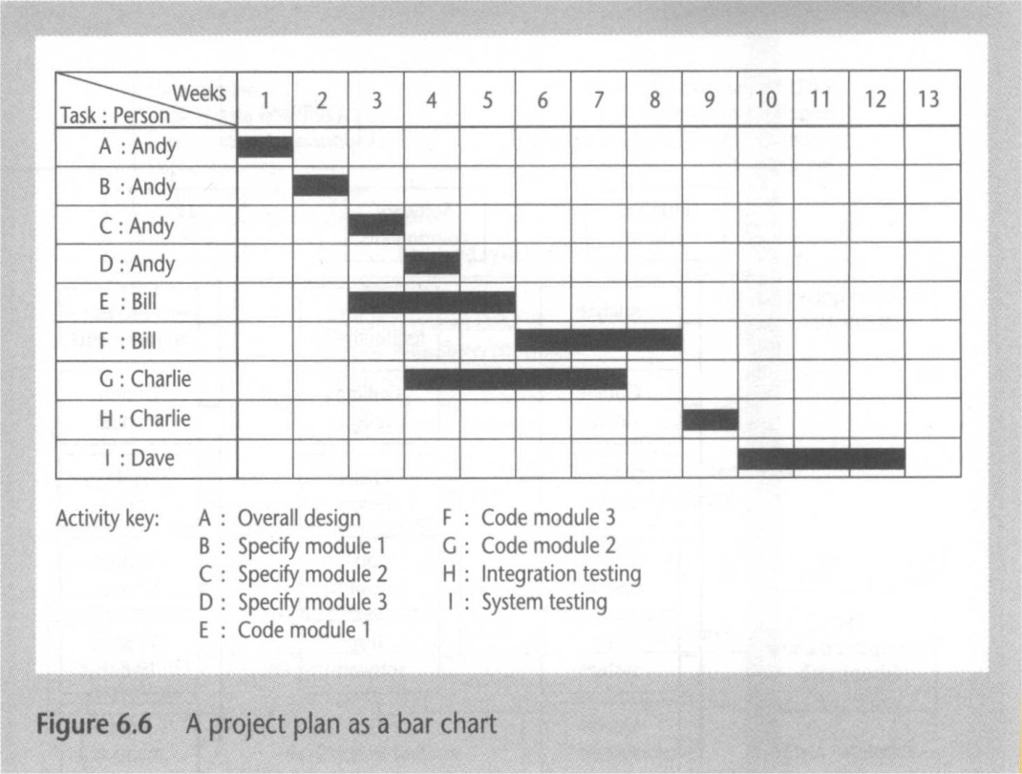
Timeline charts
MMH
MMH

Slide 7
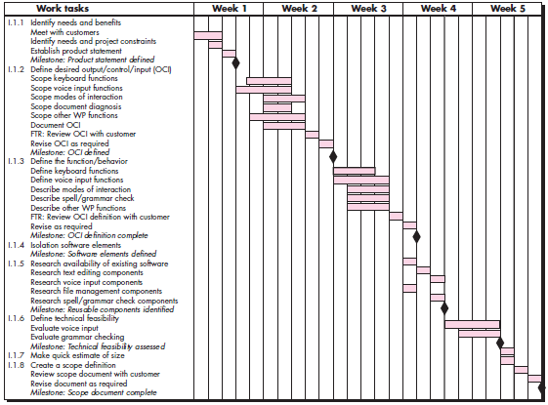
Timeline charts
Slide-7
MMH

Slide 8
Schedule tracking
Slide-8
MMH
Conduct periodic project status meetings in which each team member reports progress and problems.
Evaluate the results of all reviews conducted throughout the software engineering process.
Determine whether formal project milestones (the diamonds shown in Figure 27.3) have been accomplished by the scheduled date.
Compare actual start-date to planned start-date for each project task listed in the resource table.
Use earned value analysis to assess progress quantitatively.

Slide 9
Earned value analysis (eva)
MMH
Slide-9
Earned value
is a measure of progress
enables us to assess the “percent of completeness” of a project using quantitative analysis rather than rely on a gut feeling
“provides accurate and reliable readings of performance from as early as 15 percent into the project.”
MMH

Slide 10
Computing Earned value
MMH
Slide-10
The budgeted cost of work scheduled (BCWS) is determined for each work task represented in the schedule.
BCWS_{i} is the effort planned for work task i.
To determine progress at a given point along the project schedule, the value of BCWS is the sum of the BCWS_{i} values for all work tasks that should have been completed by that point in time on the project schedule.
The BCWS values for all work tasks are summed to derive the budget at completion, BAC. Hence,
BAC = ∑ (BCWS_{k}) for all tasks k
MMH

Slide 11
Computing Earned value
MMH
Slide-11
Budgeted cost of work performed (BCWP)
The value for BCWP is the sum of the BCWS values for all work tasks that have actually been completed by a point in time on the project schedule.
“the distinction between the BCWS and the BCWP is that the former represents the budget of the activities that were planned to be completed and the latter represents the budget of the activities that actually were completed.”
Given values for BCWS, BAC, and BCWP, important progress indicators can be computed:
Schedule performance index, SPI = BCWP/BCWS
SPI tells you how efficiently you are actually progressing compared to the planned progress.
SPI is an indication of the efficiency with which the project is utilizing scheduled resources.
Schedule variance, SV = BCWP – BCWS
MMH

Slide 12
Computing Earned value
Slide-12
MMH
Percent scheduled for completion = BCWS/BAC
provides an indication of the percentage of work that should have been completed by time t.
Percent complete = BCWP/BAC
provides a quantitative indication of the percent of completeness of the project at a given point in time, t.
Actual cost of work performed, ACWP, is the sum of the effort actually expended on work tasks that have been completed by a point in time on the project schedule. It is then possible to compute
Cost performance index, CPI = BCWP/ACWP
The Cost Performance Index helps you analyze the efficiency of the cost utilized by the project.
Cost variance, CV = BCWP – ACWP

Slide 13
EVA exercise
Slide-13
MMH
Assume you are a software project manager and you’ve been asked to compute earned value statistics for a small software project.
The project has 56 planned work tasks that are estimated to require 582 person-days to complete.
At the time that you’ve been asked to do the earned value analysis, 12 tasks have been completed.
However the project schedule indicates that 15 tasks should have been completed.
The following scheduling data (in person-days) are avalable:

Slide 14
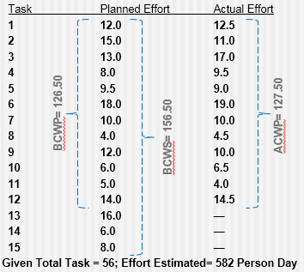
EVA exercise
Slide-14
MMH
BAC = 582.00
SPI = BCWP/ BCWS = 126.5/ 156.5 = 0.808307
SV = BCWP - BCWS = 126.5 - 156.5 = -30 person-day
CPI = BCWP/ ACWP = 0.99
CV = BCWP – ACWP = -1 person-day
% schedule for completion = BCWS/ BAC = 156.5/ 582.00 = 26.89%
[% of work scheduled to be done at this time]
% complete = BCWP/ BAC = 126.5/ 582.00 = 21.74% [% of work completed at this time]
MMH

Slide 15
references
Slide - 15
R.S. Pressman & Associates, Inc. (2010). Software Engineering: A Practitioner’s Approach.
Kelly, J. C., Sherif, J. S., & Hops, J. (1992). An analysis of defect densities found during software inspections. Journal of Systems and Software, 17(2), 111-117.
Bhandari, I., Halliday, M. J., Chaar, J., Chillarege, R., Jones, K., Atkinson, J. S., & Yonezawa, M. (1994). In-process improvement through defect data interpretation. IBM Systems Journal, 33(1), 182-214.

